Slide 1

Linear Algebra
For Machine Learning
By Alex Joslin

Slide 2
Matrix Addition
-7 9
1 5
10 0
6 7
3 9
7 12
+
=
Can only add them if both matrices
have the same dimensions.
Same rules for subtraction.

Slide 3
Scalar Multiplication
-2
9
-6
8 27
3
*
=
Same rules for division.

Slide 4
Matrix Multiplication (dot product)
Check to see if you can even
multiply two matrixes together.
columns: 2
columns: 3
7
1
2
rows: 1
8 5 3
*
rows: 3
1 X 3
3 X 2
# of columns in 1st matrix must equal
# of rows in 2nd matrix
✓
1 X 3
3 X 2
1 X 3
3 X 2
1 X 2
result

Slide 5
Matrix Multiplication
7
1
2
8 5 3
*
✓
A
*
B
7
1
2
*
8 5 3
B
A
?
*

Slide 6
Matrix Multiplication
A
*
B
B
*
A
columns: 2
columns: 2
columns: 3
7
1
2
7
1
2
columns: 3
rows: 1
8 5 3
*
rows: 3
rows: 3
*
8 5 3
rows: 1
1 X 3
3 X 2
3 X 2
1 X 3
✓
1 X 3
3 X 2
3 X 2
1 X 3
1 X 3
3 X 2
Order Matters
1 X 2

Slide 7
Matrix Multiplication
7
1
2
8 5 3
*
=
8*5+5*6+3*7 8*7+5*1+3*2
1 X 3
3 X 2
91 67
1 X 2

Slide 8
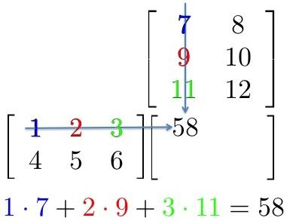
Matrix Multiplication

Slide 9
Transpose a Matrix
A → A^{T}
1 3 5
2 4 6
7 9 11
1 2 7
3 4 9
5 6 11
→

Slide 10
https://www.youtube.com/watch?v=aircAruvnKk&t=229s

